Slide 1
A pilot study in ABR and eABR examination using a novel EEG device incorporating alternate methods of examination
By Andrew Curran FH Aachen Juelich Campus Msc Candidate
June 2016
Notes:
1
1

Slide 2
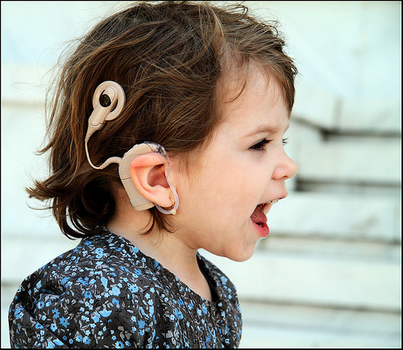
Introduction
30 million affected by deafness
50.000 new Cochlear Implants every year
ABR is used in hearing loss diagnosis
eABR used for intra and post operative monitoring
Both are quantitative and objective measurements
Picture used with permission from http://social.rollins.edu/
Notes:
2

Slide 3
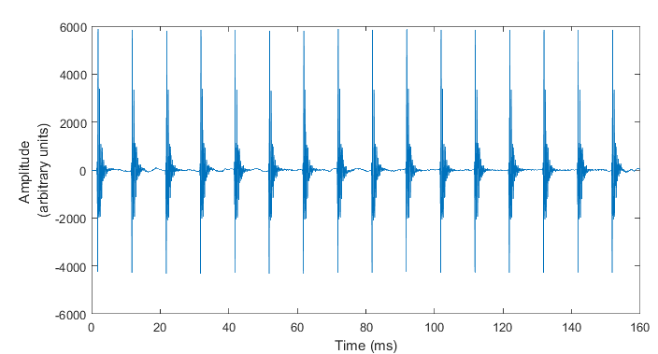
ABR
Notes:
3

Slide 4
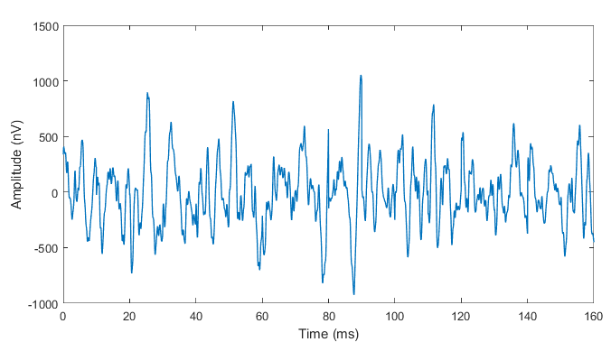
ABR
Notes:
4

Slide 5
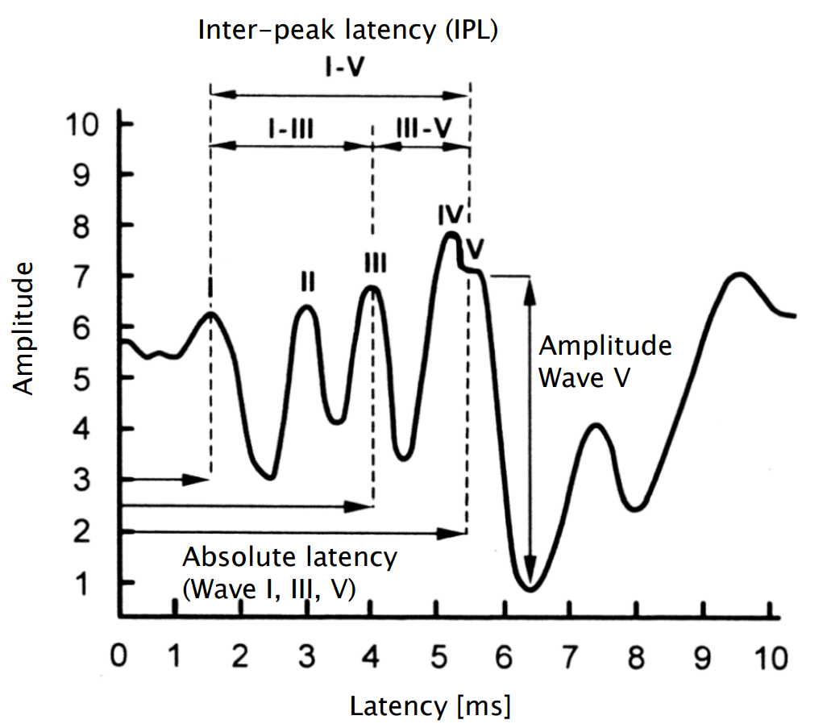
ABR
Notes:
5

Slide 6
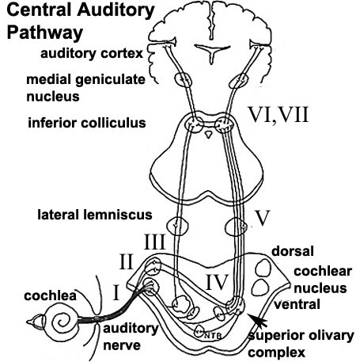
ABR
Notes:
6

Slide 7
ABR
Current usage requires specialized facilities for noise reduction
Require a clinician to both measure and interpret results
Long run-time under sedentary conditions
Limited sensitivity at low levels
Notes:
7

Slide 8
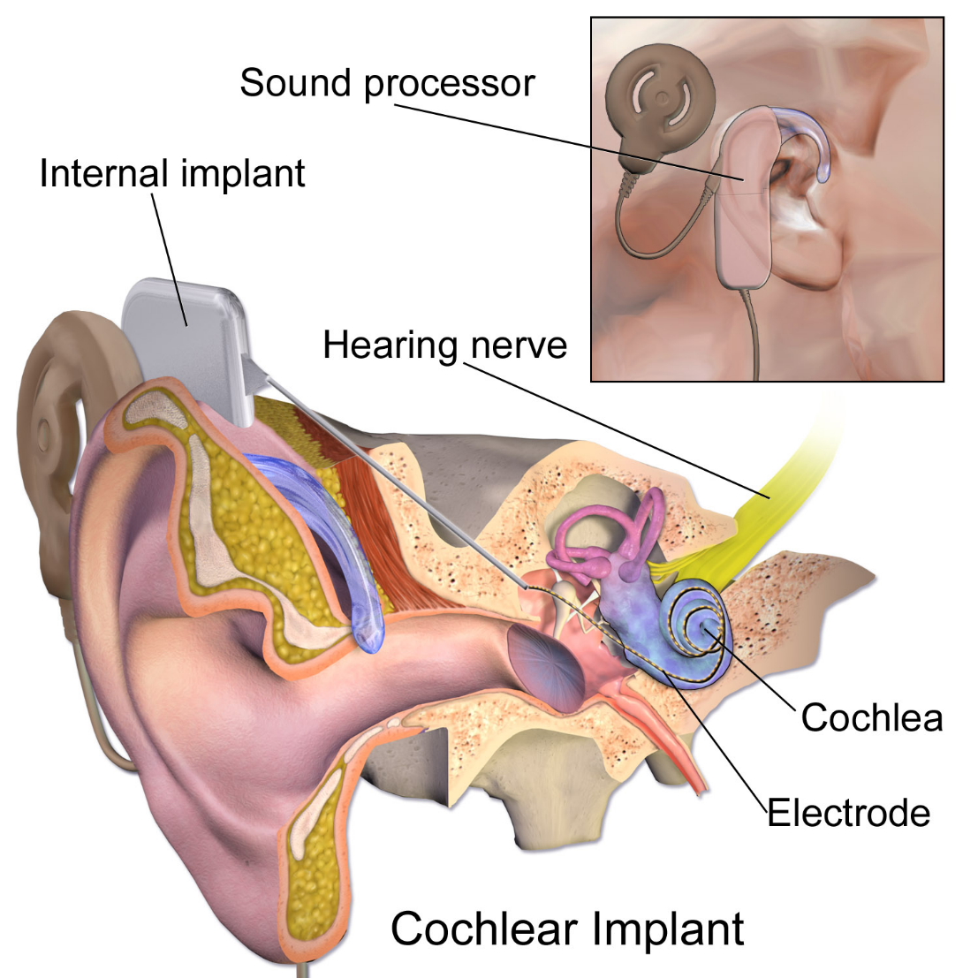
eABR
Notes:
8

Slide 9
eABR
Same drawbacks as ABR
Requires computer access for stimulation
Electrical interference from stimulation and Cochlear Implant adds artifacts and decreases sensitivity further
Notes:
9

Slide 10
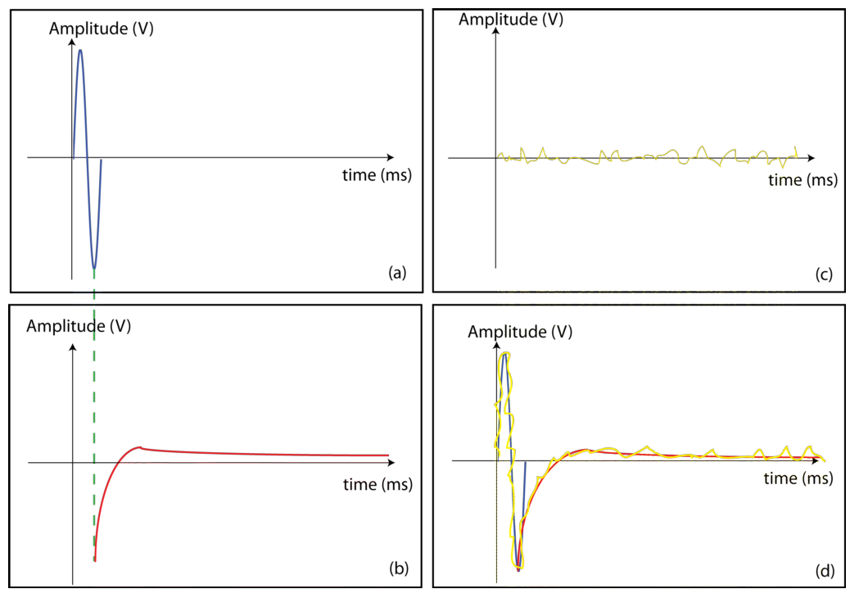
eABR
Notes:
10

Slide 11
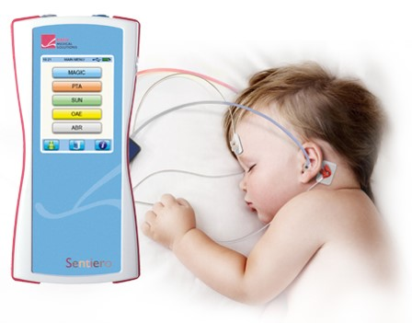
Research Objectives
Sentiero as a handheld eABR measurement solution
Investigate additional methodologies
Notes:
11

Slide 12
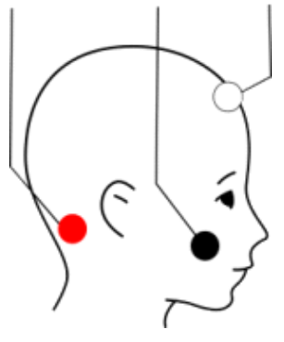
Clinical Methodology
Vertex or high
forehead
Behind the ear
Cheek
Notes:
12

Slide 13
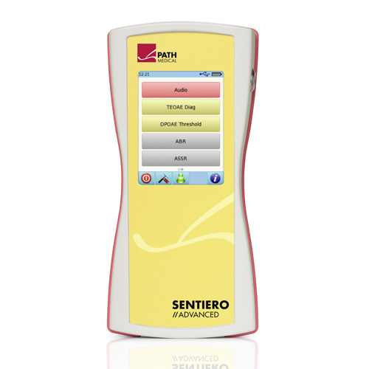
Clinical Methodology
PC with Matlab
Sentiero Audio
Output
RIBII BOX
Or
Trigger cable
Notes:
13

Slide 14
Clinical Methodology (Parallel eABR)
PC with Matlab
Double Snap
Attachement
RIBII BOX
BioPac
Trigger cable
BioPac
Disposable Electrode
Sentiero
Notes:
14

Slide 15
ABR Methodology
8 participants between ages of 21 and 31
4 male and 4 female
Limited size due to time constraints
Ipsilateral vs contralateral
Rarefaction vs condensation
80/60/40 dB SPL of rarefaction ipsilateral
Notes:
15

Slide 16
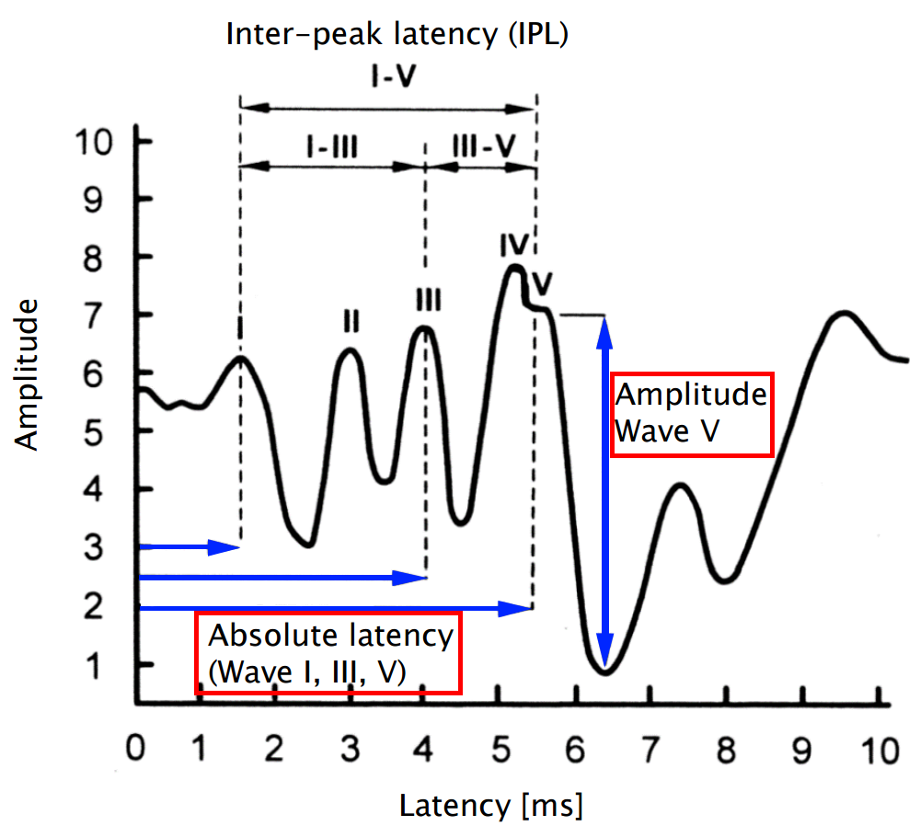
ABR Methodology
Notes:
16

Slide 17
eABR Methodology
Pilot study of n = 1 Cochlear Implant patient
aged 53 and male
unilateral Med-el implant on left side
1
2
3
4
5
6
7
8
9
10
11
12
0
286
365
443
522
1021
Below THR
THR
MCL
Max Output
0
222
410
1021
Below THR
THR
MCL
Max Output
Notes:
17

Slide 18
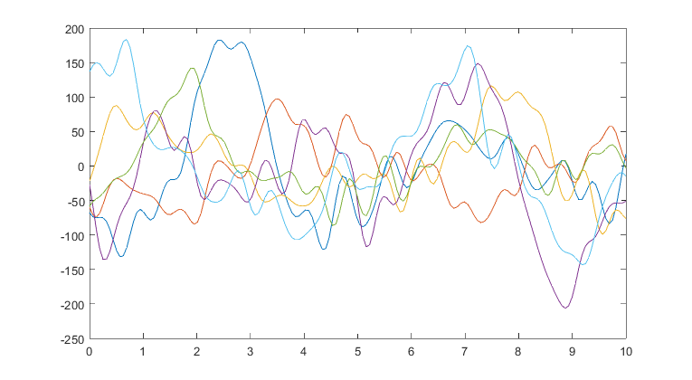
Post-Processing
Pictured: raw EEG average
Amplitude (nV)
Time (ms)
Notes:
18

Slide 19
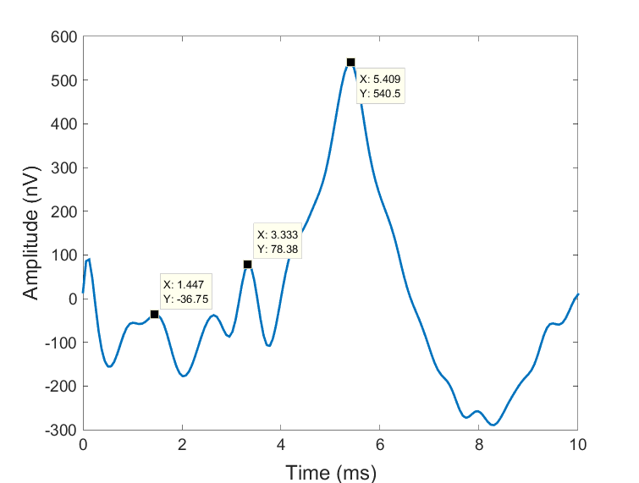
Example Results
Pictured: new processing method Bandpass formed by processing as well as resulting average
Notes:
19

Slide 20
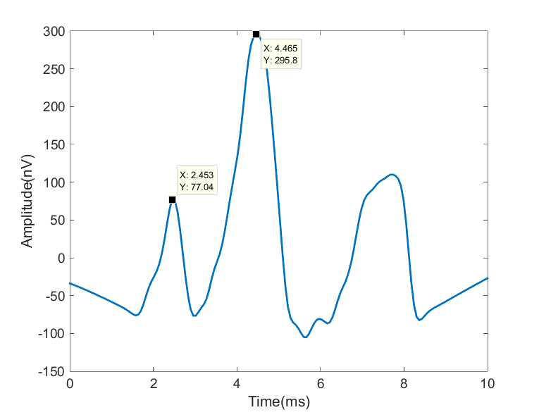
Example Results
Pictured: new processing method Bandpass formed by processing as well as resulting average
Notes:
20

Slide 21
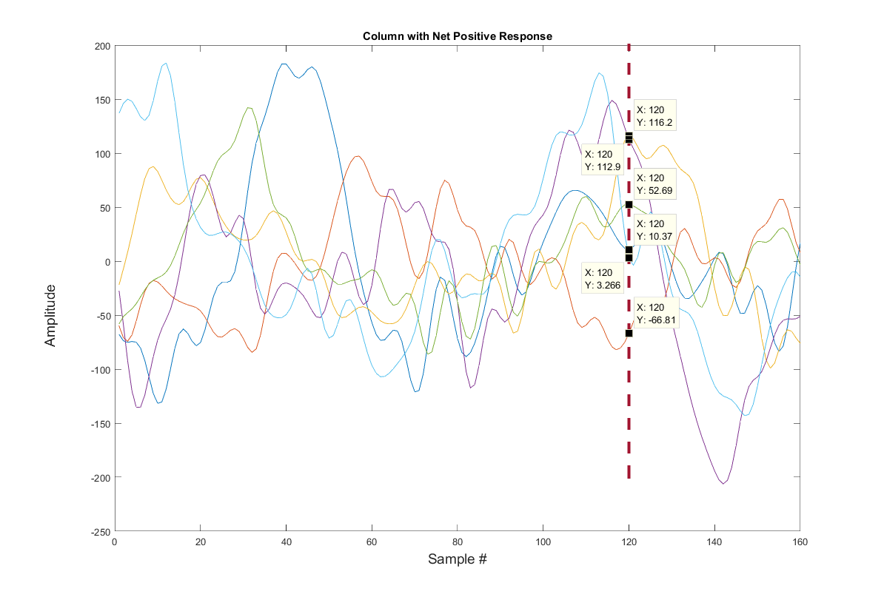
Binomial Method
200
150
100
50
0
Amplitude (nV)
-50
-100
-150
-200
-250
0
2.5
5
7.5
10
Time (ms)
Notes:
Remove
21

Slide 22
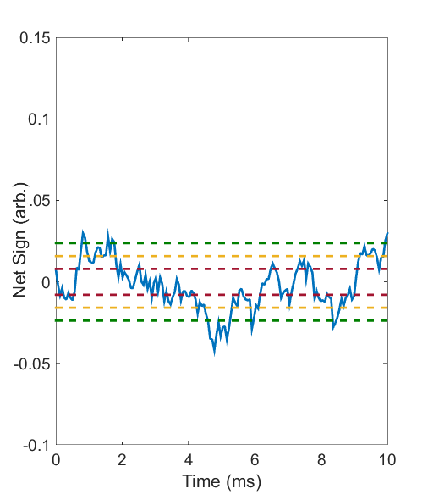
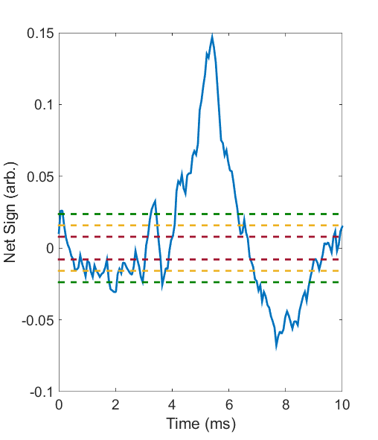
Single-Point Scattering
Notes:
Remake graphs to same scale
22

Slide 23
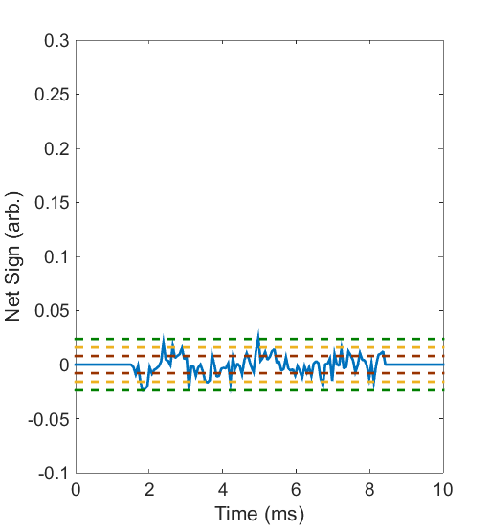
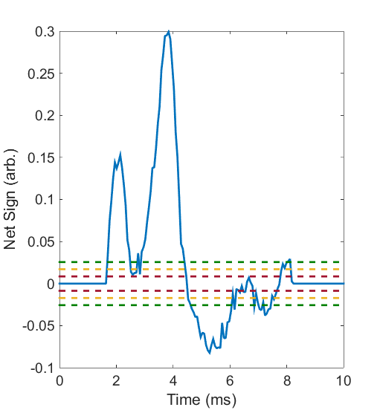
Single-Point Scattering With eABR
Notes:
Remake graphs to same scale
23

Slide 24
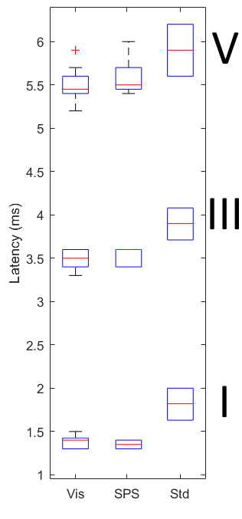
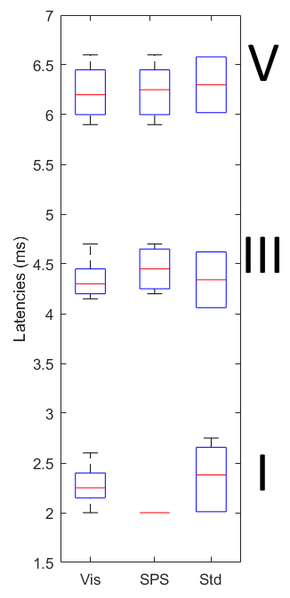
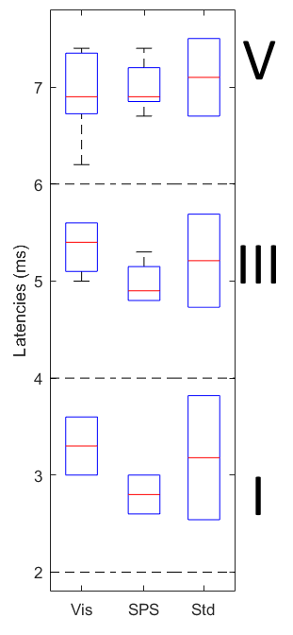
Results (Latency Estimates)
80 dB
60 dB
40 dB
Latency (ms)
Latency (ms)
Latency (ms)
VIS
SPS
LIT
VIS
SPS
LIT
VIS
SPS
LIT
Notes:
Change std to lit, remove Rej, CWT, DWT
24

Slide 25
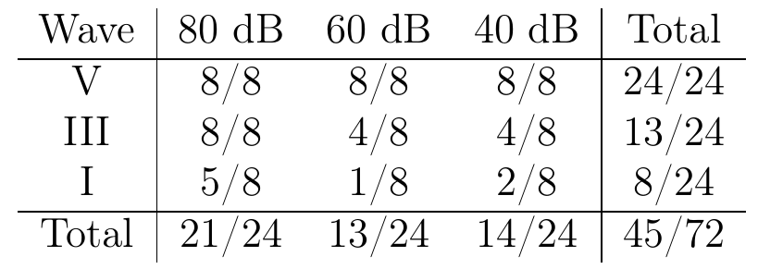
Results (SPS Significance)
Notes:
25

Slide 26
Results (SPS Significance)
Notes:
26

Slide 27
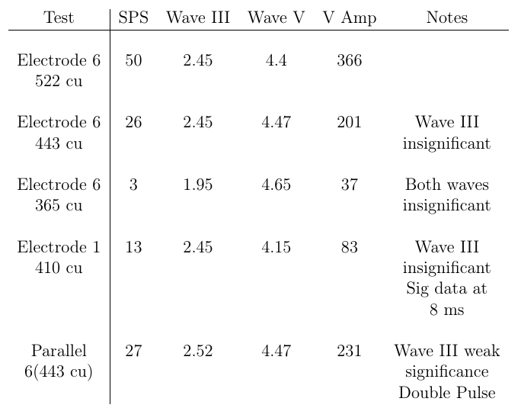
Results (eABR)
Notes:
27

Slide 28
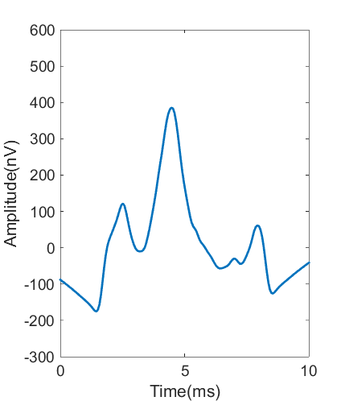
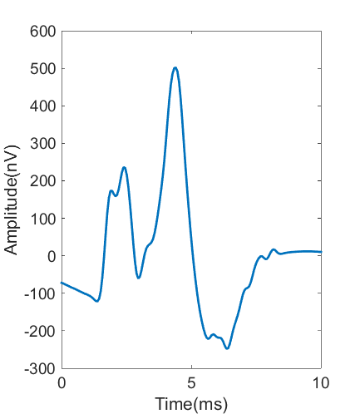
Results (eABR Parallel)
Notes:
28

Slide 29
Conclusions
Preliminary Sentiero-eABR results good. More data required
Double-snap electrode a potential avenue of further investigation
Preliminary SPS testing inconclusive
Notes:
Make more concise. Remove material dealing with removed slides
29

Slide 30
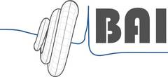
Questions and Affiliations
FH Aachen Juelich Campus
Technische Universitaet Muenchen
Notes:
30

Slide 31
Acknowledgements
Prof. Dr. Kotliar
Prof. Dr. Hemmert
Dr. Oswald and Herr Schirkonyer
M. Obando
P. Reiser
Dr. Bai, C. Wirtz, S. Keller, R. Weiss, J. Encke, A. Voss.
Notes:
31

Slide 32
Appendix: Extra Slides
Notes:
32

Slide 33
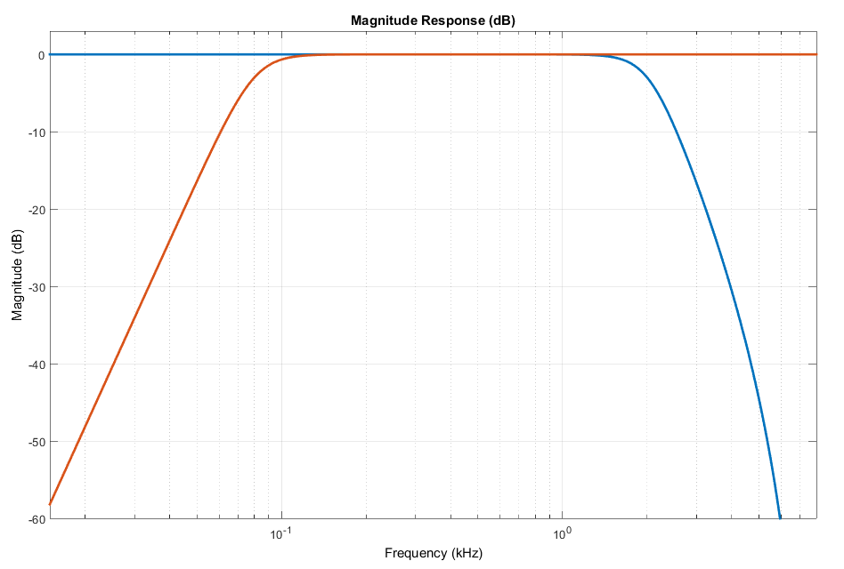
Digital Filtration
Pictured: Old processing method Bandpass/notch formed by processing as well as resulting average
Notes:
33

Slide 34
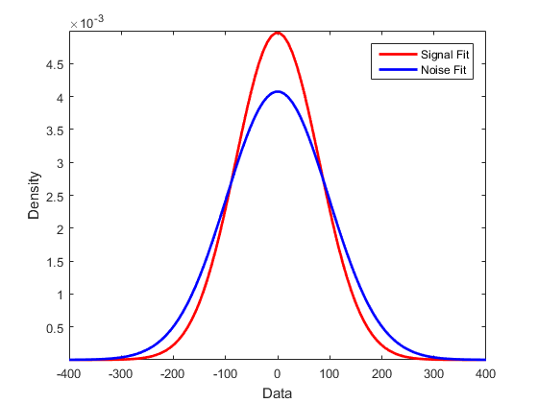
Statistical Testing
Pictured: visualization of how we can show noise != signal but cannot say that signalless = noise
Notes:
34

Slide 35
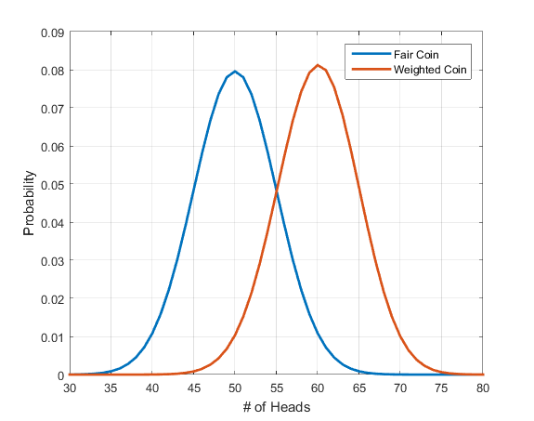
Binomial Method
Pictured: visualization of coin flip problem
Notes:
Remember to justify why we want less subjectivity -> clinicians do work by eye http://biomedical-engineering-online.biomedcentral.com/articles/10.1186/1475-925X-11-86
35

Slide 36
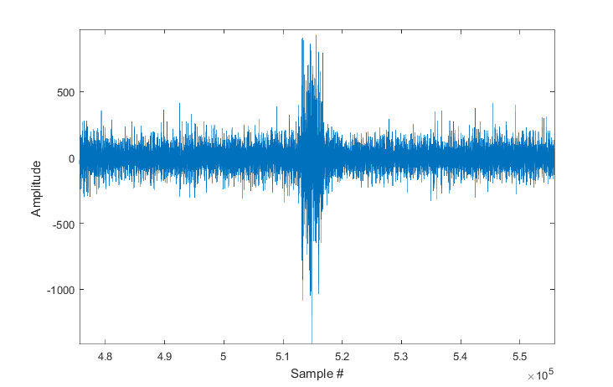
Artifact Rejection
Pictured: set of epochs contaminated by excess muscle interference
Notes:
Remove
36

Slide 37
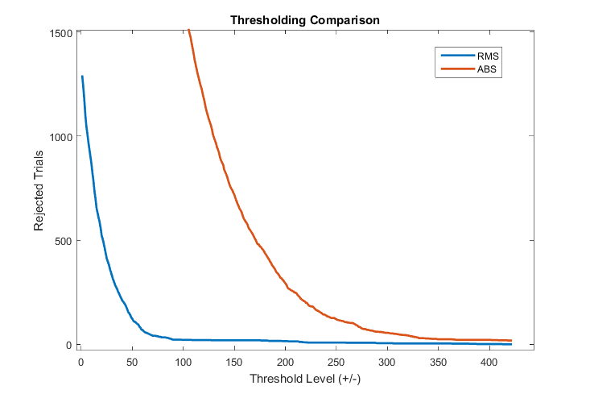
Artifact Rejection
Pictured: histograms of max value versus RMS
Notes:
Remove
37

Slide 38
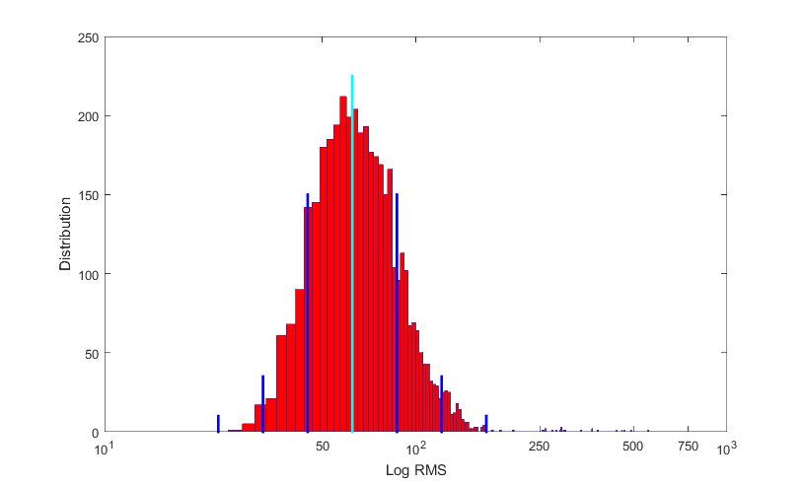
Artifact Rejection
Pictured: histogram of RMS with standard deviation lines
Notes:
Remove
38

Slide 39
Signal to Noise Ratio Estimation
AB Method
Separate epochs into two groups, A and B
A + B is indicative of signal
A – B is indicative of noise
Notes:
39

Slide 40
Signal to Noise Ratio Estimation
Weighted
Non-Stationary
Fixed
Multiple-Point
Noise Estimation
Notes:
40

Slide 41
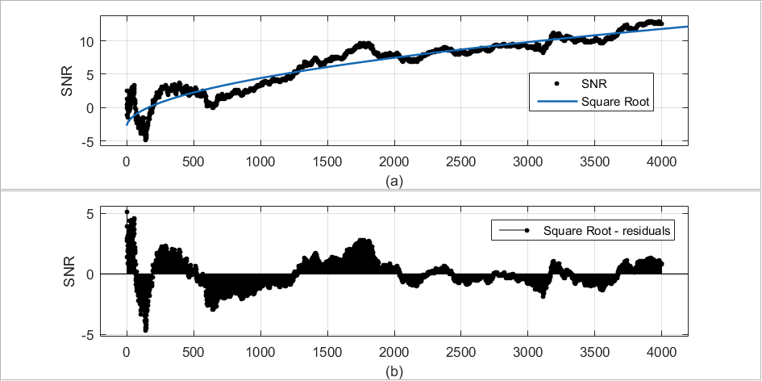
Signal to Noise Ratio Estimation
Notes:
41

Slide 42
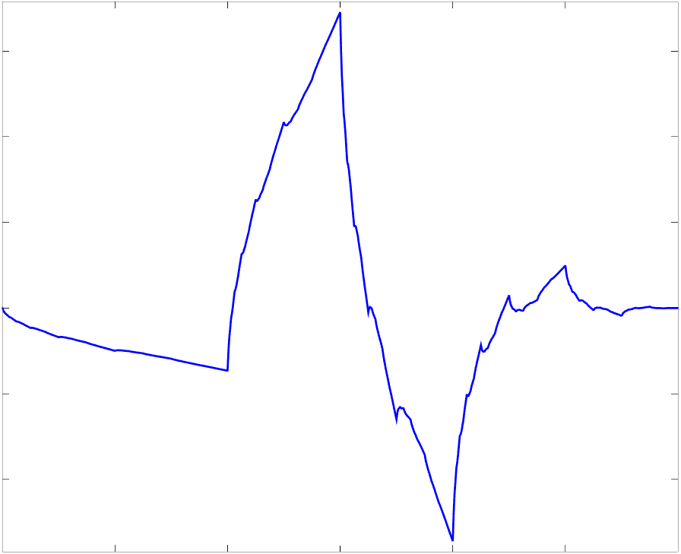
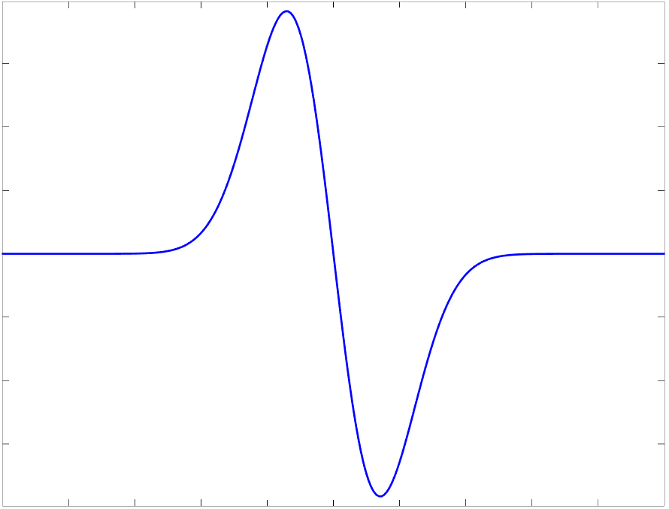
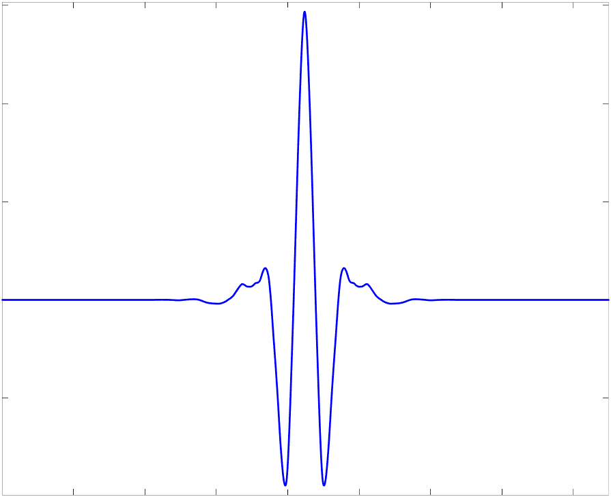
Wavelet Analysis
Haar
Daubechies
Gaussian
Biorthogonal
Notes:
42

Slide 43
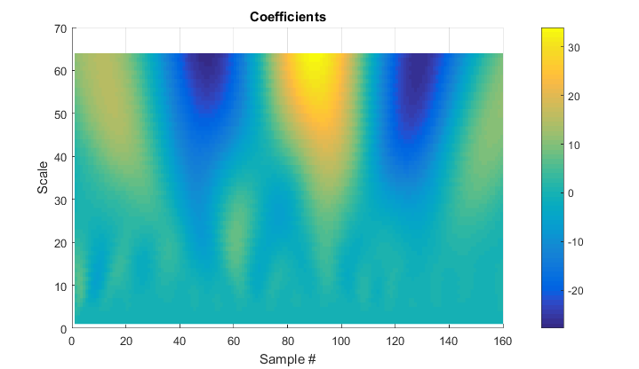
Wavelet Analysis
Notes:
43

Slide 44
Wavelet Analysis
Notes:
44

Slide 45
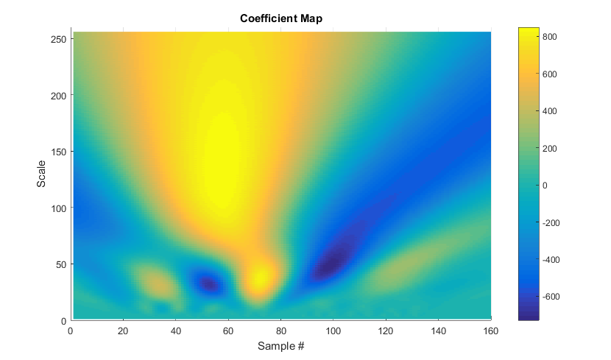
Wavelet Analysis
Notes:
45

Slide 46
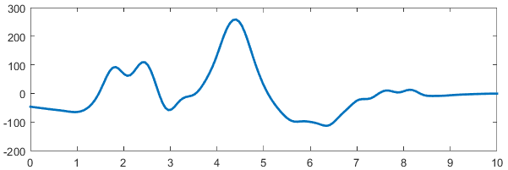
Wavelet Analysis
Notes:
46

Slide 47
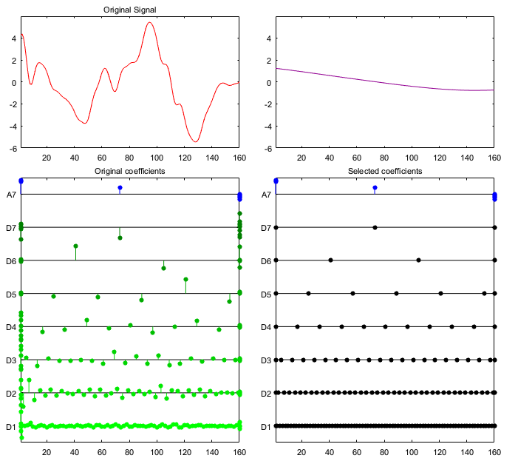
Wavelet Analysis
Notes:
47

Slide 48
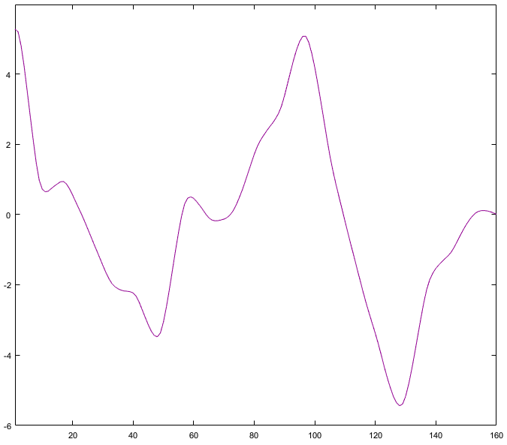
Wavelet Analysis
Notes:
48

Slide 49
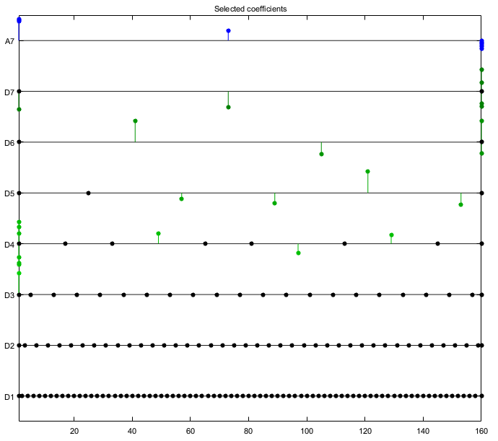
Wavelet Analysis
Notes:
49

Slide 50
Results (SPS Significance)
Notes:
50

Slide 51
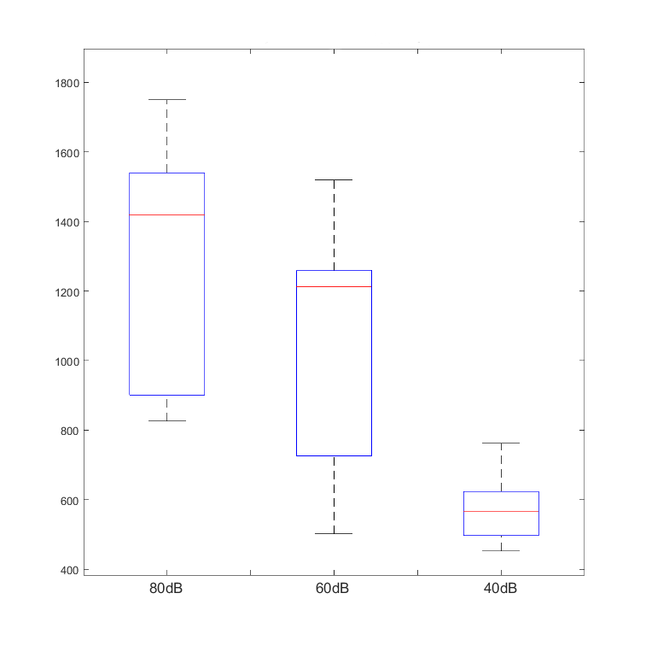
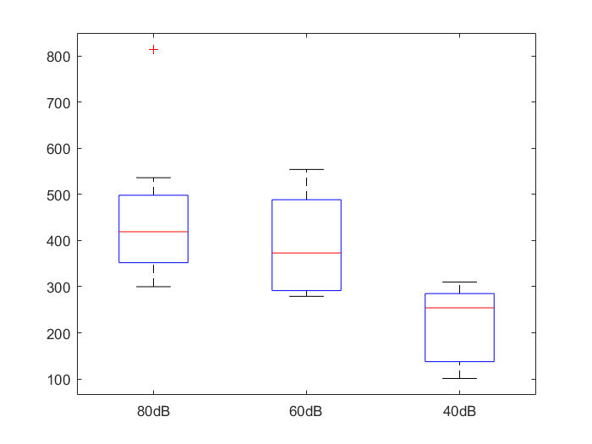
Results (Wave V Amplitudes)
CWT
Actual
Notes:
51

Slide 52
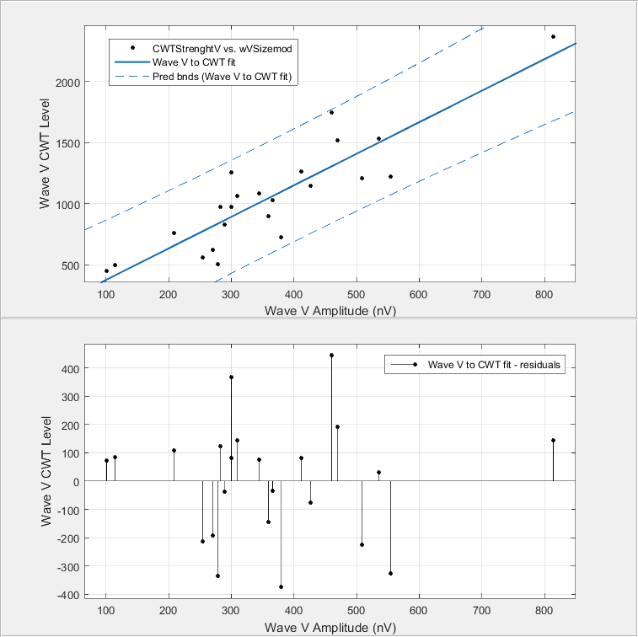
Results (Wave V Amplitudes)
Notes:
52

Slide 53
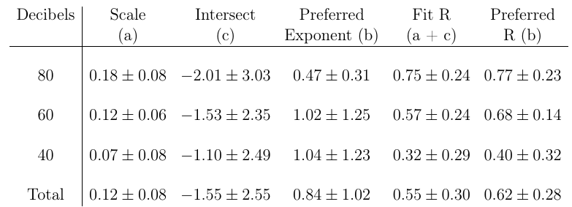
Results (SNR Estimation)
AB Method
Notes:
53

Slide 54
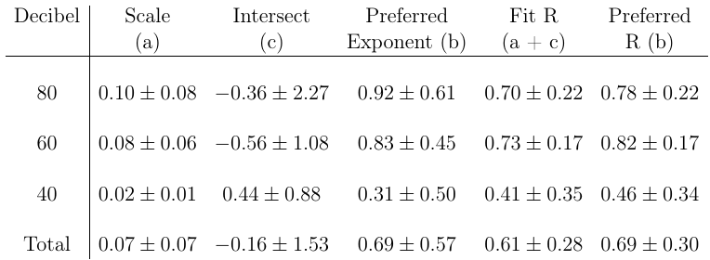
Results (SNR Estimation)
WNSFMP Method
Notes:
54

Slide 55
Conclusions
Muscle artifact rejection makes little difference in healthy adult individuals, but potential remains for toddlers and babies
CWT and DWT analysis appear viable as alternative observation methods as well as potential avenues for automation
Notes:
Make more concise. Remove material dealing with removed slides
55

Slide 56
Conclusions cont.
CWT amplitudes generally correlate positively with Wave V amplitudes although a better method of determining exactness is required.
Both AB and WNSFMP SNR estimation appear to be valid estimation methods, although care must be taken to not compare results from one to the other
Notes:
56

